Slide 1





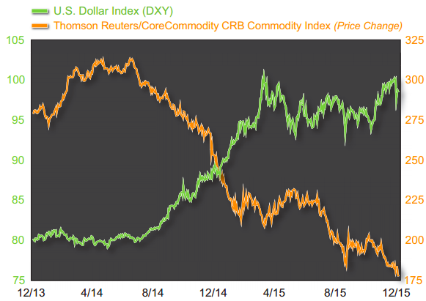
Predicting Commodities Prices:
A Data-Mining Approach
Meiqing Zhang
Erin M. Ochoa
Rodrigo Valdes

Slide 2


Data preparation
Geographic indicators
Precipitation
Temperature
Data preparation
Economic indicators
Inflation
Stock markets
Exchange rate
Industrial production
Recession cycle
Power usage

Slide 3




Commodities prices
Geographic indicators
Economic indicator: recessions
Economic indicators
Power usage
Data preparation
Data sources

Slide 4

Data Catalogs
41 Economic Indicators and 10 Commodities Prices
GEM
(Global Economic Monitor)
Countries: World and 7 major economies
Indicators: 5 economic indicators
GEM Commodities
Countries: World
Indicators: 10 commodities (dependent variables) and crude oil prices (independent variable)
Data preparation
Data collection
Source: The World Bank API

Slide 5

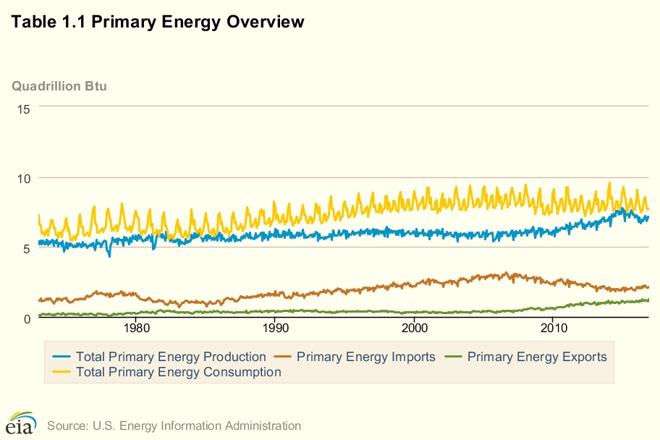
NASA Precipitation:
Global
Northern Hemisphere
Southern Hemisphere
Tropics
EIA :
11 Electricity usage variables
NBER:
Months Elapsed Since Current Recession Began
Months Elapsed Since Last Recession Ending
Data preparation
Data collection
Sources: NASA, EIA, NBER
Notes:
EIA: Energy Information Administration
NBER: National Bureau of Economic Research

Slide 6
Merging tables
Squared and cubic variables
Cleaning time formats
Unified dataframes for analysis
Data preparation
Data munging and cleaning

Slide 7
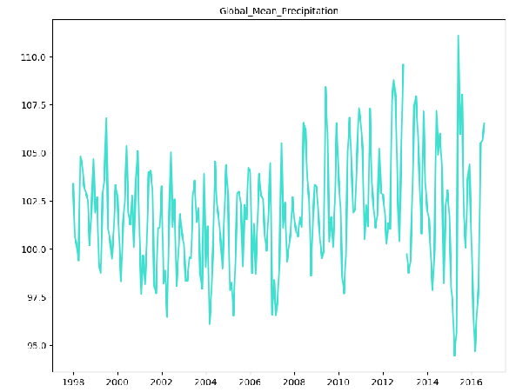
Data analysis
Diagnostic plotting

Slide 8
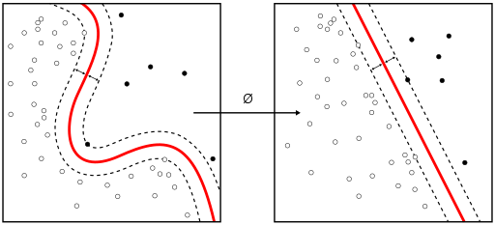
Data analysis
Forward selection model

Slide 9

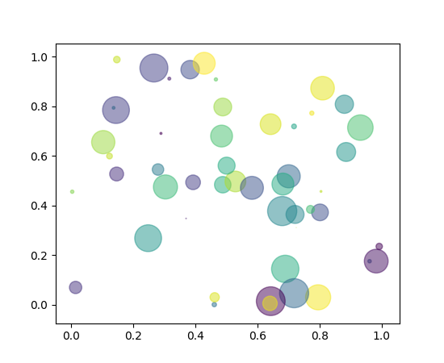
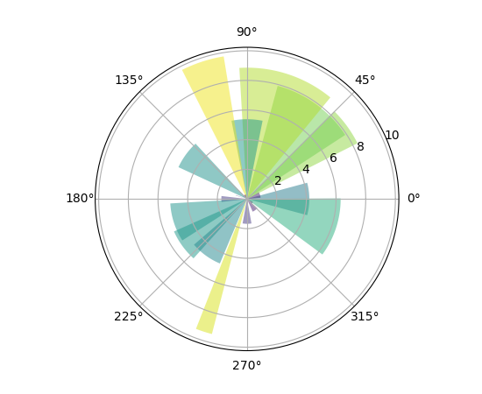
Data analysis
Results and visualization

Slide 10
Rodrigo’s plot goes here

Slide 11



Data presentation
Reporting

Slide 12

Next Steps
Analysis and graphing
Report output
Documentation

Slide 13

Thank you

